Slide 1

Modern Database Management
Thirteenth Edition, Global Edition
Chapter 4
Logical Database Design and the Relational Model
Copyright © 2020 Pearson Education Ltd. All Rights Reserved
Notes:
If this PowerPoint presentation contains mathematical equations, you may need to check that your computer has the following installed:
1) MathType Plugin
2) Math Player (free versions available)
3) NVDA Reader (free versions available)

Slide 2
Learning Objectives
4.1 Define terms
4.2 List five properties of relations
4.3 State two properties of candidate keys
4.4 Define first, second, and third normal form
4.5 Describe problems from merging relations
4.6 Transform E-R and E E R diagrams to relations
4.7 Create tables with entity and relational integrity constraints
4.8 Use normalization to decompose anomalous relations to well-structured relations

Slide 3
Components of Relational Model
Data structure
Tables (relations), rows, columns
Data manipulation
Powerful S Q L operations for retrieving and modifying data
Data integrity
Mechanisms for implementing business rules that maintain integrity of manipulated data

Slide 4
Relation
A relation is a named, two-dimensional table of data.
Consists of rows (records) and columns (attribute or field)
Requirements for a table to qualify as a relation:
It must have a unique name.
Every attribute value must be atomic (not multivalued, not composite).
Every row must be unique (can’t have two rows with exactly the same values for all their fields).
Attributes (columns) in tables must have unique names.
The order of the columns must be irrelevant.
The order of the rows must be irrelevant.
Note: All relations are in 1st Normal form.
Notes:
All relations are tables, but not all tables are relations. Think of a “table” as simply being a grid with rows and columns. In this sense, a spreadsheet could be a “table”. To qualify as a relation, each row would need to be unique, which implies that each row needs to have a primary key.

Slide 5
Correspondence with E-R Model
Relations (tables) correspond with entity types and with many-to-many relationship types.
Rows correspond with entity instances and with many-to-many relationship instances.
Columns correspond with attributes.
Note: The word relation (in relational database) is not the same as the word relationship (in E-R model).
Notes:
People often confuse the term “relation” with the term “relationship”. A relation is a table that follows certain rules, and refers to actual relational database architecture. A relationship is a conceptual term that refers to how entities relate to each other. The E-R concept of relationship will be implemented by primary and foreign keys connecting the database’s relations.

Slide 6
Key Fields
Keys are special fields that serve two main purposes:
Primary keys are unique identifiers of the relation. Examples include employee numbers, social security numbers, etc. This guarantees that all rows are unique.
Foreign keys are identifiers that enable a dependent relation (on the many side of a relationship) to refer to its parent relation (on the one side of the relationship).
Keys can be simple (a single field) or composite (more than one field).
Keys are usually used as indexes to speed up the response to user queries.
Notes:
Keys are to databases as identifiers are to E-R models.

Slide 7
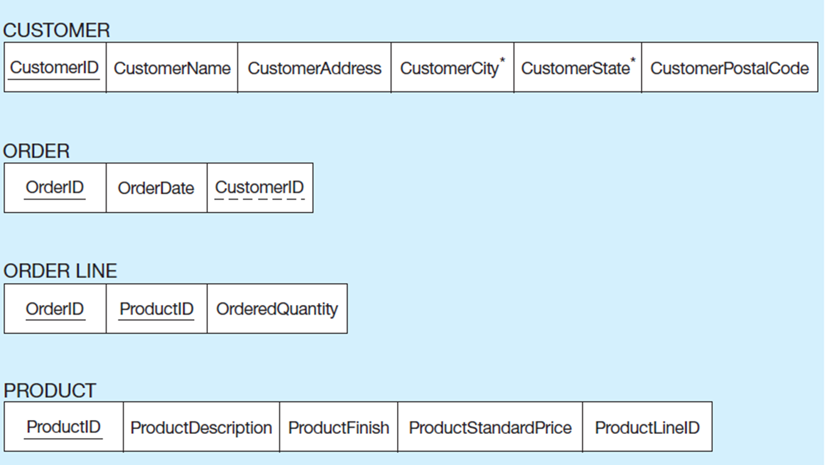
Figure 4-3 Schema for Four Relations (Pine Valley Furniture Company
a) E E R notation
Notes:
Solid underlines indicate primary key. Dashed underline indicates foreign key.
In Order Line there is a composite primary key (OrderID and ProductID together). Each of these fields are also foreign keys to the other relations (Order and Product).
The relation on the many side of a 1:N relationship will have a foreign key that corresponds with the primary key of the relation on the one side.
Any time you have a M:N relationship between entities, this must be implemented via a separate relation, often called an “intersection table” or a “junction table”. The Order Line table is an example of a relation that implements a many-to-many relationship between orders and products. Each order may involve several products, and likewise each product could be involved in many orders.

Slide 8
Integrity Constraints (1 of 2)
Domain Constraints
Allowable values for an attribute (includes data types and restrictions on values)
Entity Integrity
No primary key attribute may be null. All primary key fields MUST contain data values.
Referential Integrity
Rules that maintain consistency between the rows of two related tables.

Slide 9
Integrity Constraints (2 of 2)
Referential Integrity – rule states that any foreign key value (on the relation of the many side) MUST match a primary key value in the relation of the one side.(Or the foreign key can be null.)
For example: Delete Rules
Restrict – don’t allow delete of “parent” side if related rows exist in “dependent” side
Cascade – automatically delete “dependent” side rows that correspond with the “parent” side row to be deleted
Set-to-Null – set the foreign key in the dependent side to null if deleting from the parent side → not allowed for weak entities
Notes:
Because some tables are dependent on others, it is important to control how data is to be deleted. Referential integrity rules prevent data from being deleted when there is other data dependent on it. For example, a customer will not be deleted from the database if there are existing orders that were generated by that customer. The delete rules specify how such deletions can be controlled within the database.

Slide 10
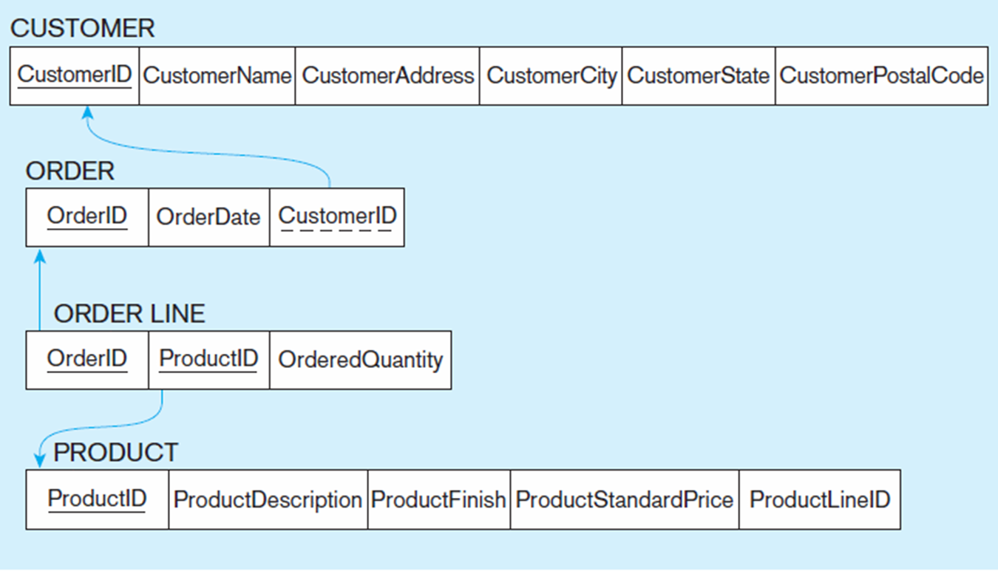
Figure 4-5 Referential Integrity Constraints (Pine Valley Furniture)
Referential integrity constraints are drawn via arrows from dependent to parent table
Notes:
In the relation diagrams of this chapter, arrows between foreign and primary keys depict referential integrity constraints.

Slide 11
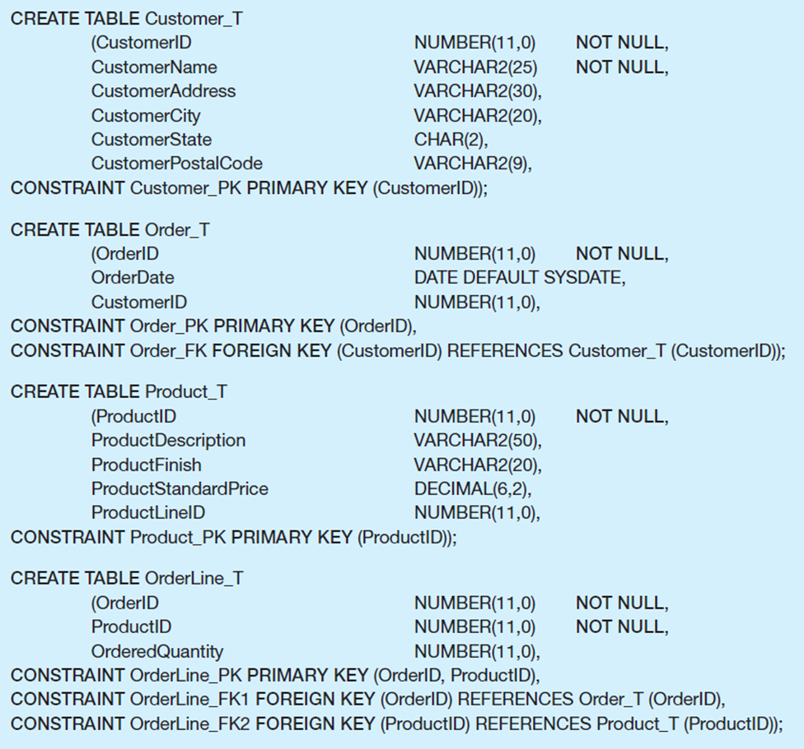
Figure 4-6 S Q L Table Definitions
Referential integrity constraints are implemented with foreign key to primary key references.
Notes:
This is an example of CREATE TABLE statements in SQL. Here we can see how a dependent table references its dominant table through creation of a foreign key. We will learn more about CREATE TABLE in Chapter 6.

Slide 12
☑ Check Point
Which one of the following sentences is correct? A) All relations are tables, but not all tables are relations. B) For a relation, the order of the columns is important. C) A relation is a three-dimensional table (entity, relationship, attribute) of data. D) A relation is same as a relationship.
<--- ANSWER --->
A) All relations are tables, but not all tables are relations.

Slide 13
Transforming E E R Diagrams into Relations (1 of 7)
Mapping Regular Entities to Relations
Simple attributes: E-R attributes map directly onto the relation
Composite attributes: Use only their simple, component attributes
Multivalued attributes: Become a separate relation with a foreign key taken from the superior entity
Notes:
The next several slides show the mechanics of designing relational databases based on E-R and EER data models. As we saw in Chapter 1, the database development life cycle often involves first constructing a conceptual model (E-R or EER) and then using this to create the logical model (relational database design). If you do a thorough job of developing the conceptual model, it should be a fairly simple matter to convert this to a well-structured relational database.
However, if you just start by creating tables, you could wind up with a database that is not well-structured, which will require you to fix these mistakes. This is the process of normalization, which will be discussed later.

Slide 14

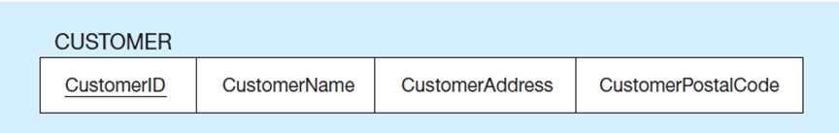
Figure 4-8 Example of Mapping a Regular Entity
a) CUSTOMER entity type
b) CUSTOMER relation
Notes:
Very simple. Each attribute of the entity becomes a column (field) of the resulting relation. The identifier of the entity becomes a primary key in the relation.

Slide 15
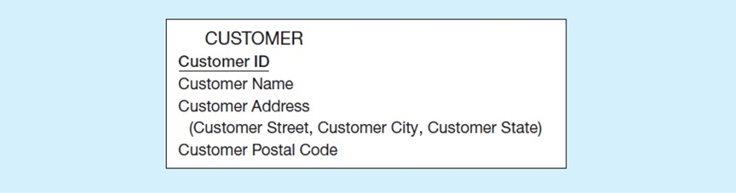
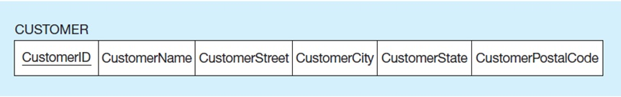
Figure 4-9 Mapping a Composite Attribute
a) CUSTOMER entity type with composite attribute
b) CUSTOMER relation with address detail
Notes:
A bit more complex. Although conceptually you can have a composite attribute, there is no such thing as a “composite column” or “composite field” in relational databases. So, the component attributes become individual columns. As you can see, there is no field called “Customer Address” in the relation, just its components.

Slide 16

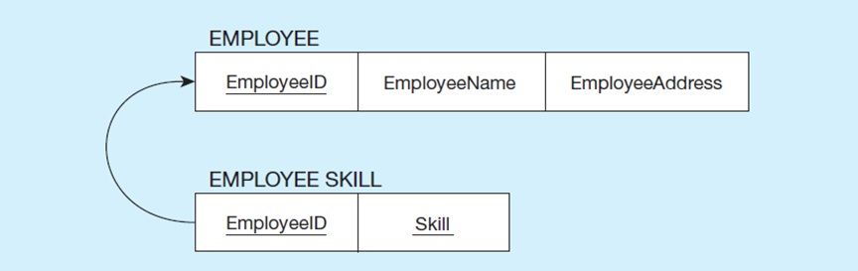
Figure 4-10 Mapping an Entity with a Multivalued Attribute
a) EMPLOYEE entity type with multivalued attribute
b) EMPLOYEE and EMPLOYEE SKILL relations
Notes:
Multivalued attributes in E-R models must be converted to separate relations in the logical database design. This is because there is no such thing as a multivalued attribute in relational databases. Remember the rules for 1st normal form.
In this case, there is a one-to-many relationship in the final database structure. The Employee Skill relation has a composite primary key (EmployeeID and Skill). The EmployeeID portion of this composite primary key is also a foreign key to the Employee table.

Slide 17
Transforming E E R Diagrams into Relations (2 of 7)
Mapping Weak Entities
Becomes a separate relation with a foreign key taken from the superior entity
Primary key composed of:
Partial identifier of weak entity
Primary key of identifying relation (strong entity)

Slide 18
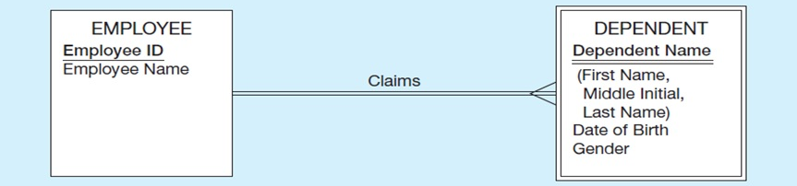
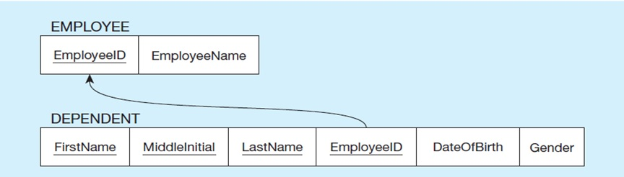
Figure 4-11 Example of Mapping a Weak Entity
a) Weak entity DEPENDENT
b) Relations resulting from weak entity
Notes:
If a foreign key is null, this implies an “optional one” in the 1:N relationship. But for weak entities this will never be the case. The weak entity cannot exist without its corresponding strong entity. So, the domain constraint for the foreign key should NOT allow null value if DEPENDENT is a weak entity.

Slide 19
Transforming E E R Diagrams into Relations (3 of 7)
Mapping Binary Relationships
One-to-Many – Primary key on the one side becomes a foreign key on the many side
Many-to-Many – Create a new relation with the primary keys of the two entities as its primary key
One-to-One – Primary key on mandatory side becomes a foreign key on optional side

Slide 20
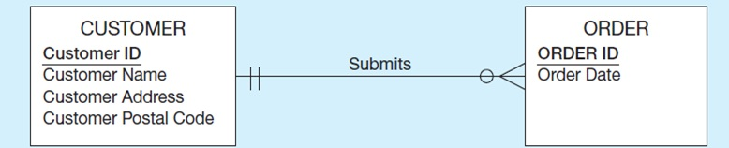
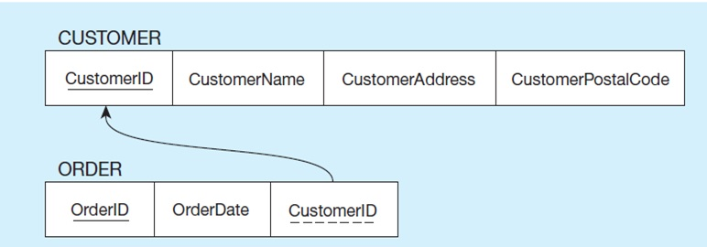
Figure 4-12 Example of Mapping a 1 colon N Relationship
a) Relationship between customers and orders
b) CUSTOMER and ORDER relations with a foreign key in ORDER
Notes:
Because of the mandatory one in the relationship, we could have modeled ORDER as a weak entity and Submits as an identifying relationship.
In E-R diagrams, we generally don’t depict the idea of a “foreign key”. This is because the only purpose of a foreign key is to implement the relationship; it is not a meaningful piece of data in itself.

Slide 21
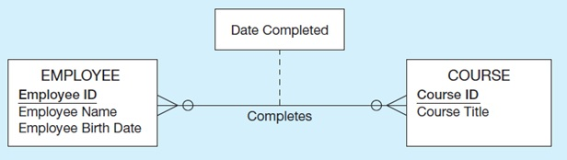
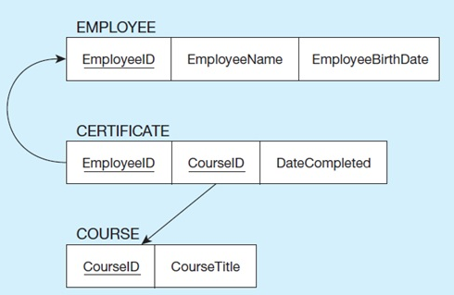
Figure 4-13 Example of Mapping an M colon N Relationship
a) Completes relationship
b) Three resulting relations
Notes:
Note that any time you have a many-to-many relationship, whether or not it contains its own attributes, it must be implemented as a separate relation (table). Often this is called an intersection table or junction table.
In this example, the new table’s primary key is a composite, formed by two foreign keys, one to each of the entities comprising the M:N relationship (Employee and Course).

Slide 22
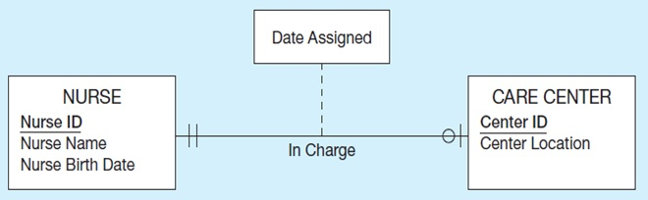
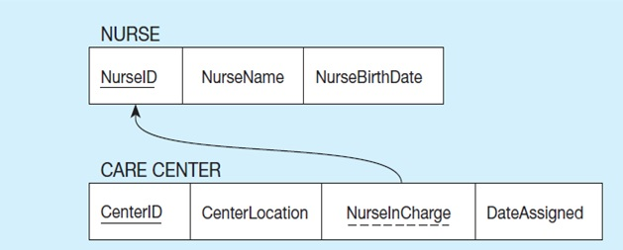
Figure 4-14 Example of Mapping a Binary 1 colon 1 Relationship
a) In charge relationship
b) Resulting relations
Notes:
Although 1:1 relationships are less common than 1:N or M:N, they still can occur. This E-R diagram shows that a nurse could be in charge of at most one care center, and that each care center must have exactly one nurse in charge.
So, since the care center must have a charge nurse, this means the foreign key in this relationship goes into the Care Center table. Also, because of the mandatory one in the relationship, this must mean that the NurseInCharge field can never have a null value.

Slide 23
Transforming E E R Diagrams into Relations (4 of 7)
Mapping Associative Entities
Identifier Not Assigned
Default primary key for the association relation is composed of the primary keys of the two entities (as in
relationship)
Identifier Assigned
It is natural and familiar to end-users
Default identifier may not be unique
Notes:
As we saw in Chapter 2, M:N relationships can also be modeled as associative entities. Sometimes this is preferable. Associative entities will map onto intersection tables in the resulting logical database design.

Slide 24
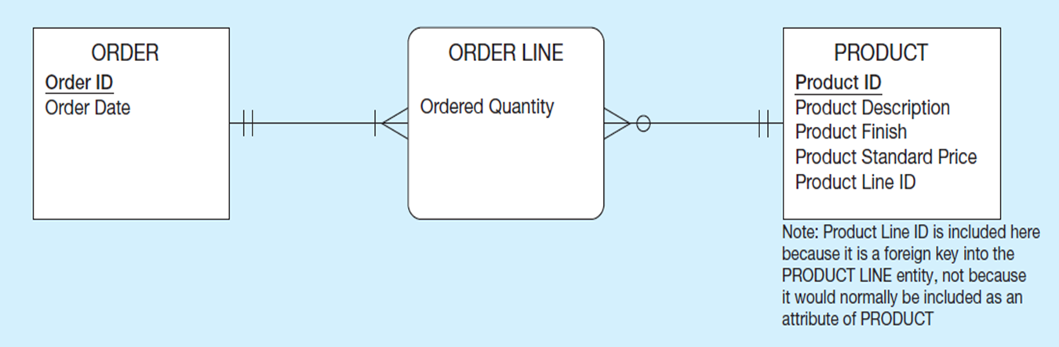
Figure 4-15 Example of Mapping an Associative Entity (1 of 2)
a) An associative entity
Notes:
Here, Order Line, which implements a M:N relationship between Order and Product, is explicitly modelled as an associative entity.

Slide 25
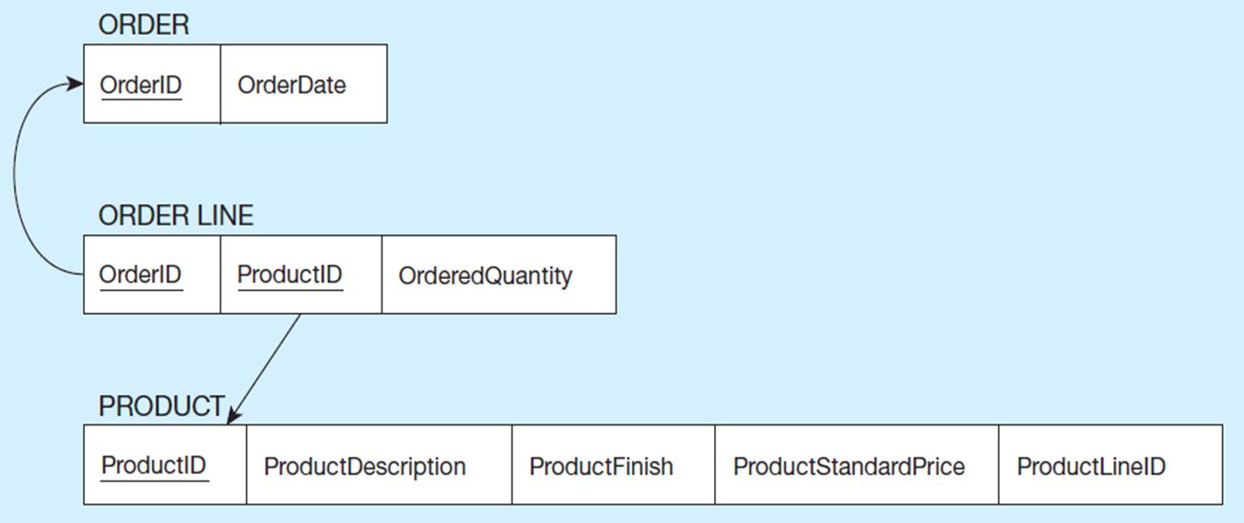
Figure 4-15 Example of Mapping an Associative Entity (2 of 2)
b) Three resulting relations
Composite primary key formed from the two foreign keys
Notes:
The resulting intersection table connects orders to products. The same would have been true if there was just a M:N relationship (instead of an associative entity) in the E-R model.
So, mapping associative entities to relational databases is essentially identical to mapping M:N relationships to relational databases.
There can only be one order line between a particular product and a particular order. You can’t duplicate the same OrderID with the same ProductID.

Slide 26
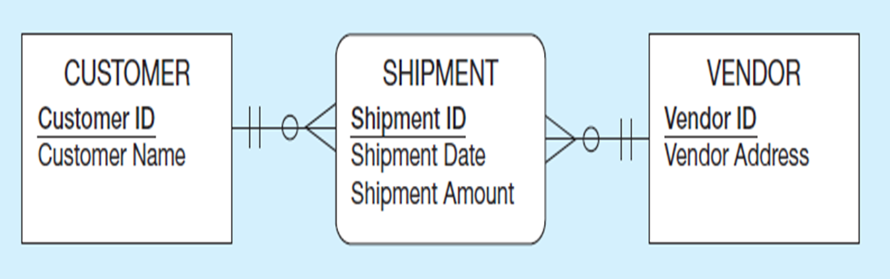
Figure 4-16 Example of Mapping an Associative Entity with an Identifier (1 of 2)
a) SHIPMENT associative entity
Notes:
In this case, the associative entity has its own identifier… (continued on next slide)

Slide 27
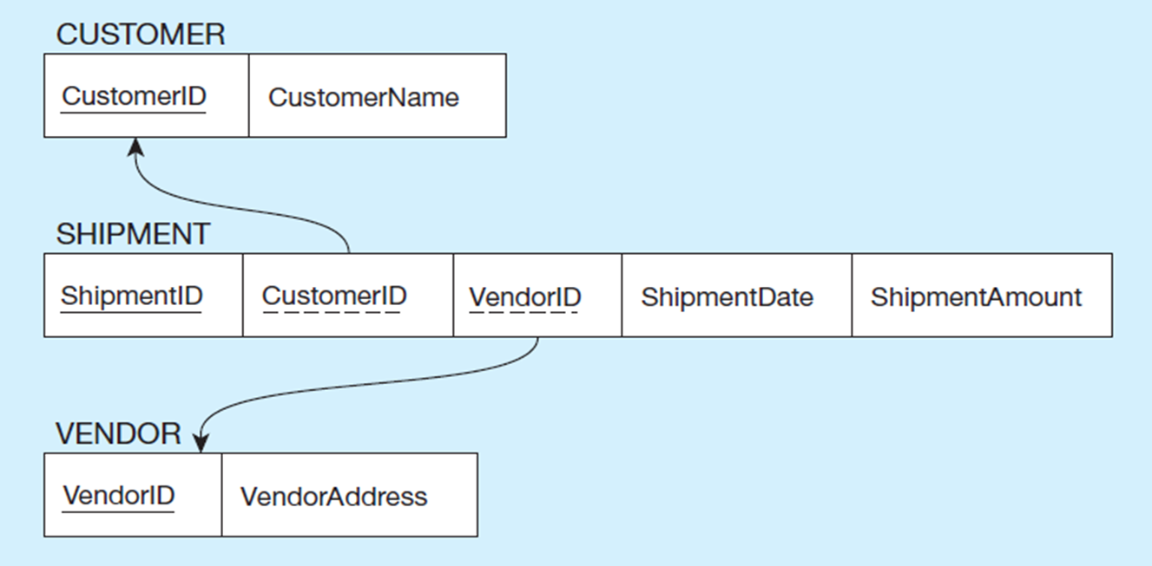
Figure 4-16 Example of Mapping an Associative Entity with an Identifier (2 of 2)
b) Three resulting relations
Primary key differs from foreign keys
Notes:
…thus, the foreign keys of the resulting intersection relation are not part of the primary key.
So, it is possible to have multiple shipments from the same vendor to the same customer.

Slide 28
Transforming E E R Diagrams into Relations (5 of 7)
Mapping Unary Relationships
One-to-Many – Recursive foreign key in the same relation
Many-to-Many – Two relations:
One for the entity type
One for an associative relation in which the primary key has two attributes, both taken from the primary key of the entity

Slide 29
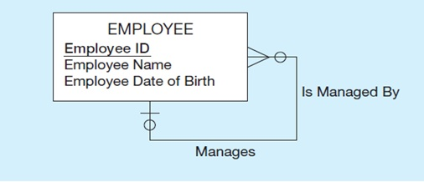
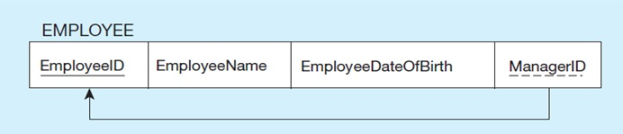
Figure 4-17 Example of Mapping a Unary 1 colon N Relationship
a) EMPLOYEE entity with unary relationship
b) EMPLOYEE relation with recursive foreign key
Notes:
The E-R diagram involves a one-to-many relationship. Thus, the foreign key is in the same table as the primary key. This is often called a “recursive” key because it points at records in the same table.
Because of the optional relationship, it is possible for an employee not to have any supervisor. Therefore, the ManagerID field could be null.
This structure is an example of storing hierarchies. It enables the representation of a supervisor who has subordinates, and these subordinates could in turn manage other subordinates, etc.

Slide 30
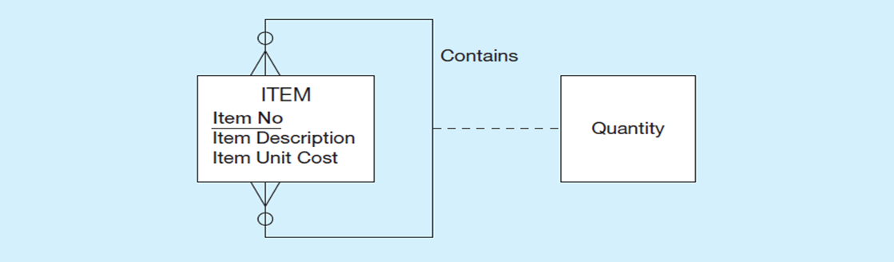
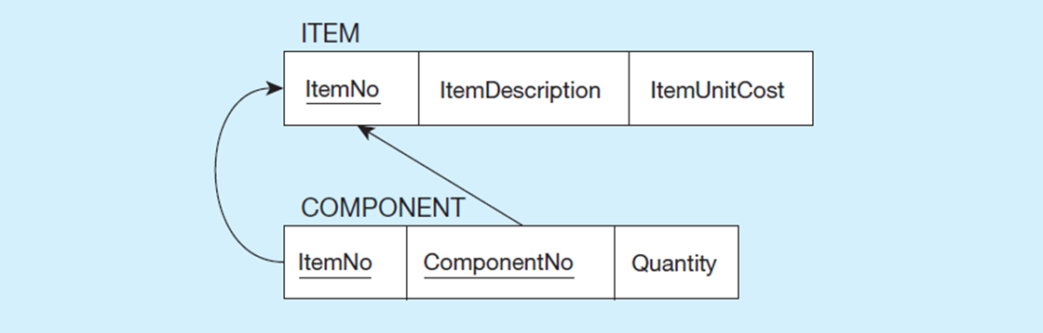
Figure 4-18 Example of Mapping a Unary M colon N Relationship
a) EMPLOYEE entity with unary relationship
b) EMPLOYEE relation with recursive foreign key
Notes:
As always, any many-to-many relationship requires a separate table (relation).
Bill-of-materials is another classic example of representing hierarchies in a database. An item may have sub-items, which could in turn have other sub-items, etc. However, there is a difference between this and the employees example from earlier. A given employee can have only one direct manager (1:N). But a component could conceivably be part of many other items (M:N).

Slide 31
Transforming E E R Diagrams into Relations (6 of 7)
Mapping Ternary (and n-ary) Relationships
One relation for each entity and one for the associative entity
Associative entity has foreign keys to each entity in the relationship

Slide 32
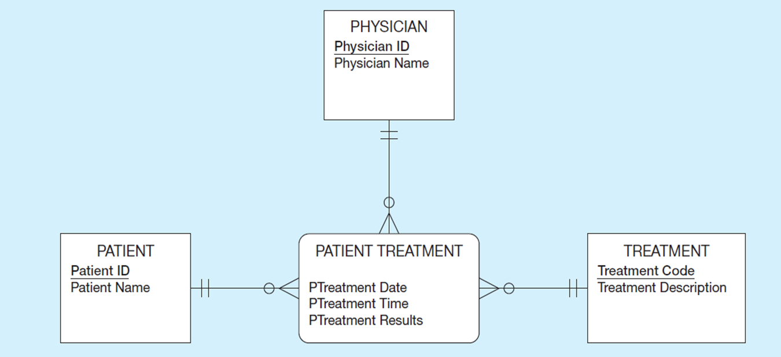
Figure 4-18 Example of Mapping a Ternary Relationship (1 of 2)
a) PATIENT TREATMENT ternary relationship with associative entity
Notes:
Note that this E-R diagram shows that a given physician can give a particular treatment to a particular patient, and that this could happen more than once.

Slide 33
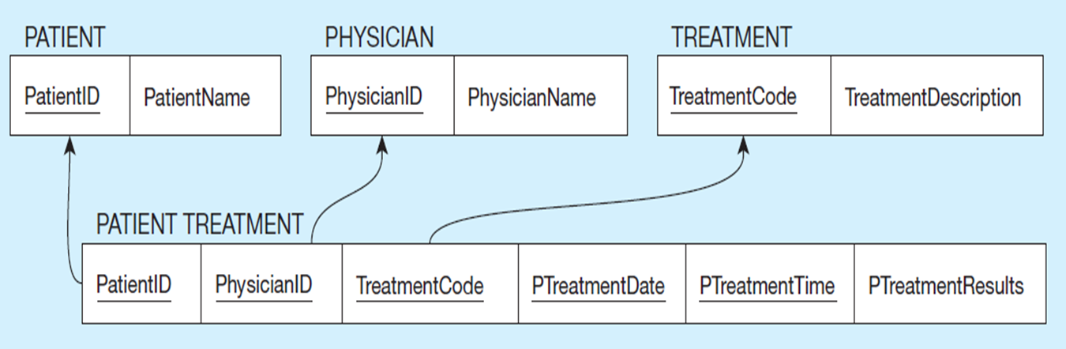
Figure 4-18 Example of Mapping a Ternary Relationship (2 of 2)
b) Four resulting relations
Notes:
Remember that the primary key MUST be unique.
This is why the primary key of the Patient Treatment table needs more than just the three foreign keys to Physician, Treatment, and Patient. If the composite primary key was composed of just the foreign keys, then a given physician could make a particular treatment for a particular patient only once.
This is why date and time are part of the primary key. This way a physician may give the same treatment to the same patient multiple times, but only once at each date/time.
But this creates a primary key consisting of five separate columns.
Suppose later we were to create a table that depends on patient treatment. If we did this, then that table would have a five-field foreign key! Very cumbersome.
So, the solution would be to have a surrogate primary key. If you have large composite primary keys, this is an indicator that a surrogate key is preferable.

Slide 34
Transforming E E R Diagrams into Relations (7 of 7)
Mapping Supertype/Subtype Relationships
One relation for supertype and for each subtype
Supertype attributes (including identifier and subtype discriminator) go into supertype relation
Subtype attributes go into each subtype; primary key of supertype relation also becomes primary key of subtype relation
relationship established between supertype and each subtype, with supertype as primary table

Slide 35
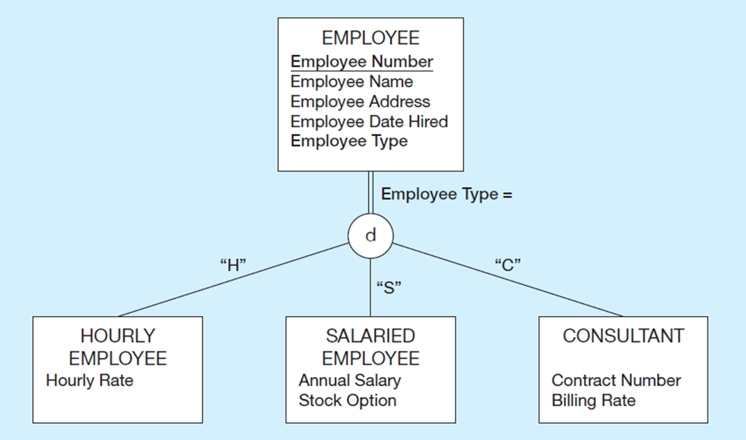
Figure 4-20 Supertype/Subtype Relationships
Notes:
Supertype-subtype relationships are essentially 1:1 relationships. So the rules that apply to these mappings will be similar to the rules we applied to other 1:1 relationship mappings, as we will see in the next slide.

Slide 36
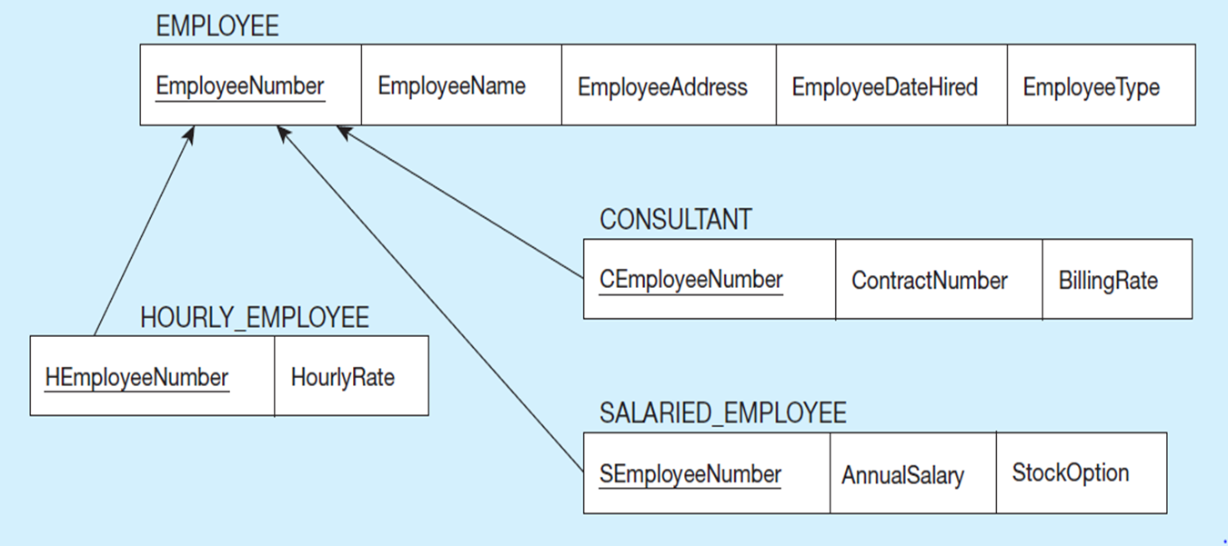
Figure 4-21 Example of Mapping Supertype/Subtype Relationships to Relations
These are implemented as one-to-one relationships.
Notes:
The primary key of the subtype relation (table) is also a foreign key to the supertype relation. Note that we have not seen this before. We have seen composite primary keys where a part of the primary key is a foreign key, but we have not seen a case where the entire primary key is also a foreign key.
Therefore, if you ever see a database table where the entire primary key is also a foreign key, this should imply to you that there is a supertype-subtype relationship involved.

Slide 37
☑ Check Point
Which one of the following is incorrect while mapping ER to relational model? A) We create a new table for a subtype entity. B) We create a new table for a multi-valued attribute. C) We create a new table for a M:N relationship. D) We create a new table for a 1:1 relationship.
<--- ANSWER --->
D) We create a new table for a 1:1 relationship.

Slide 38

Copyright

